Slide 1
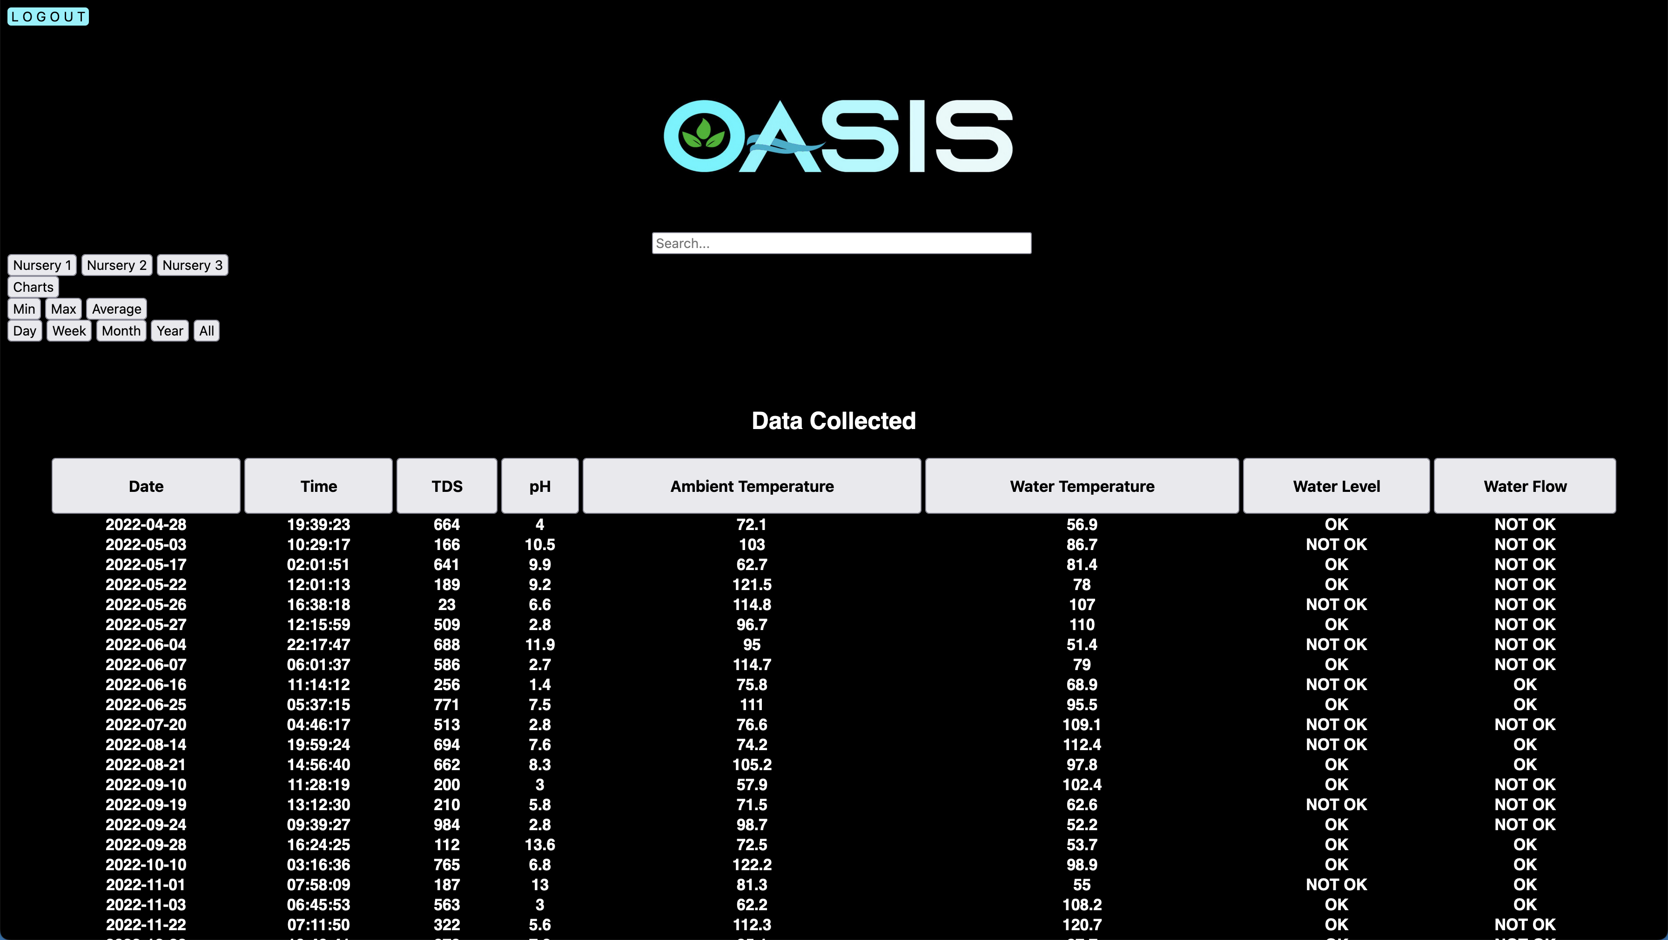
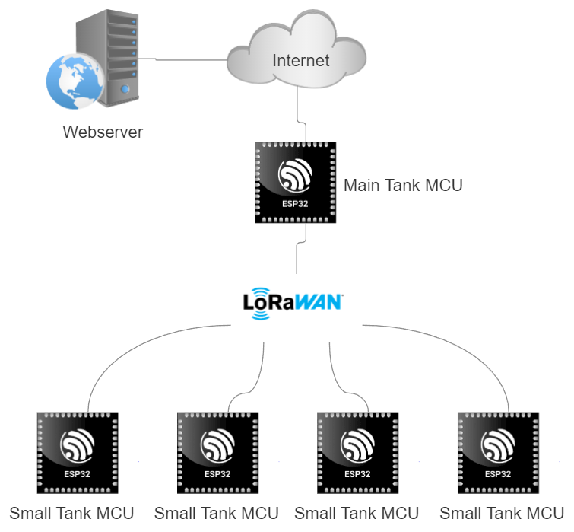
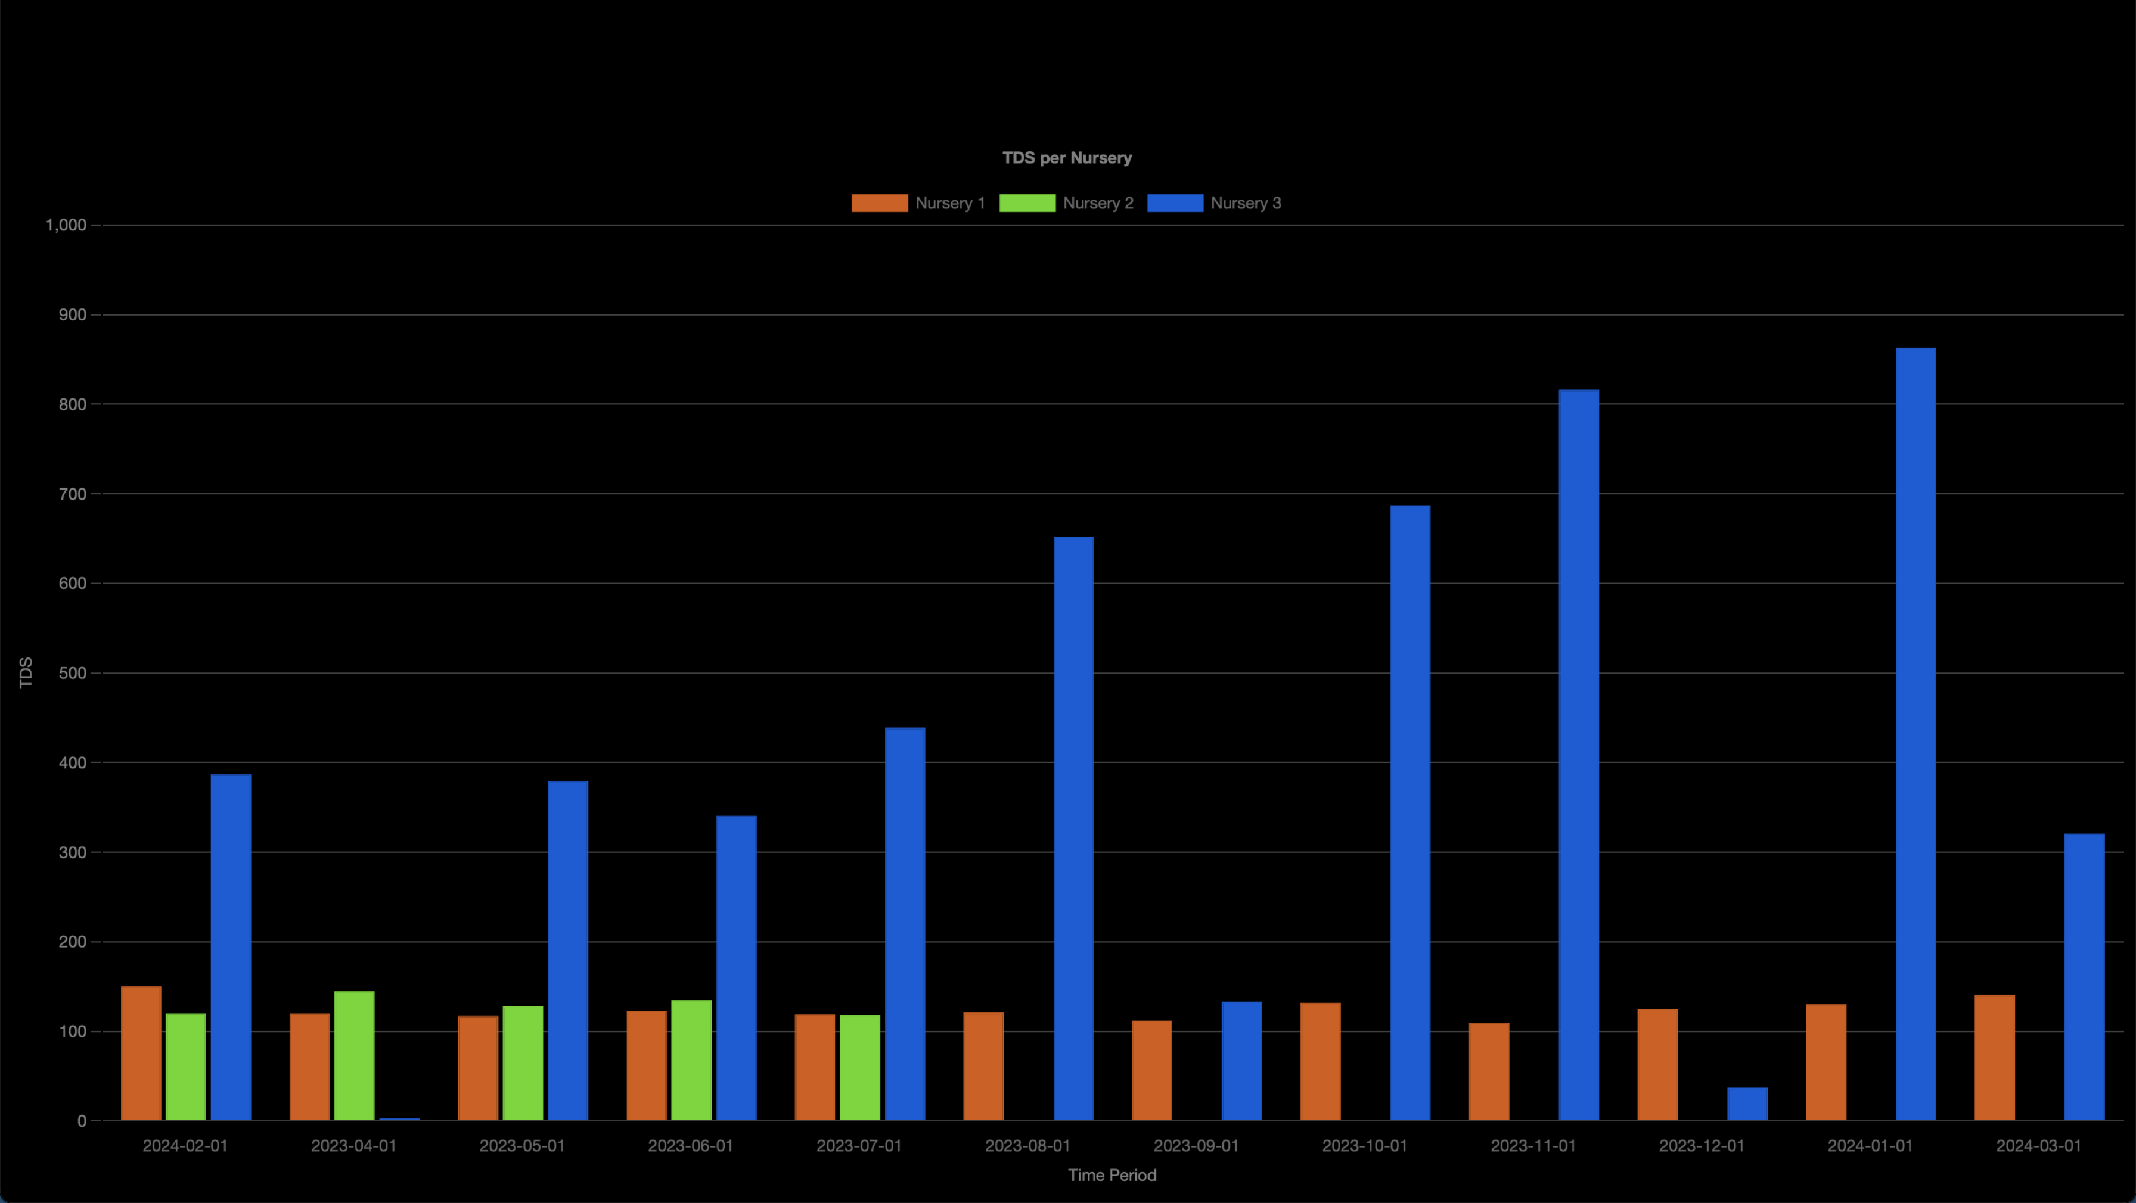
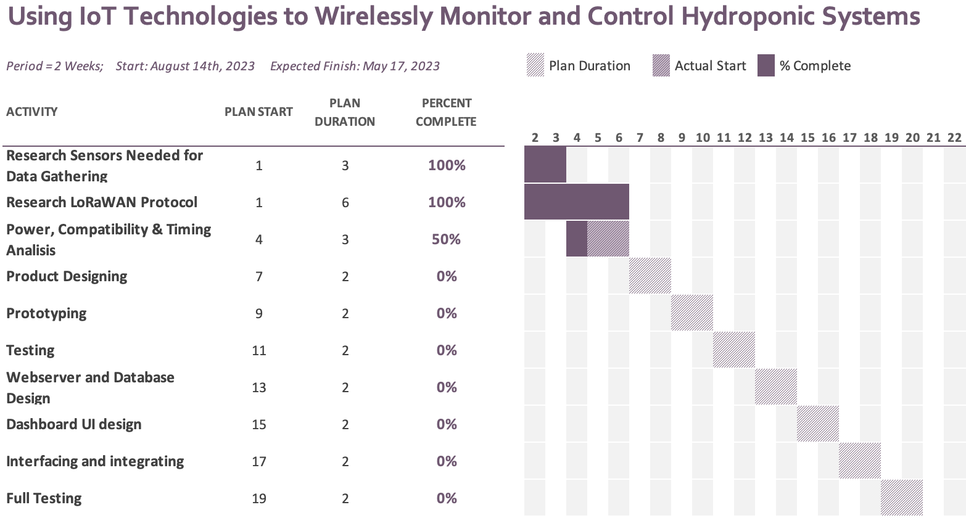
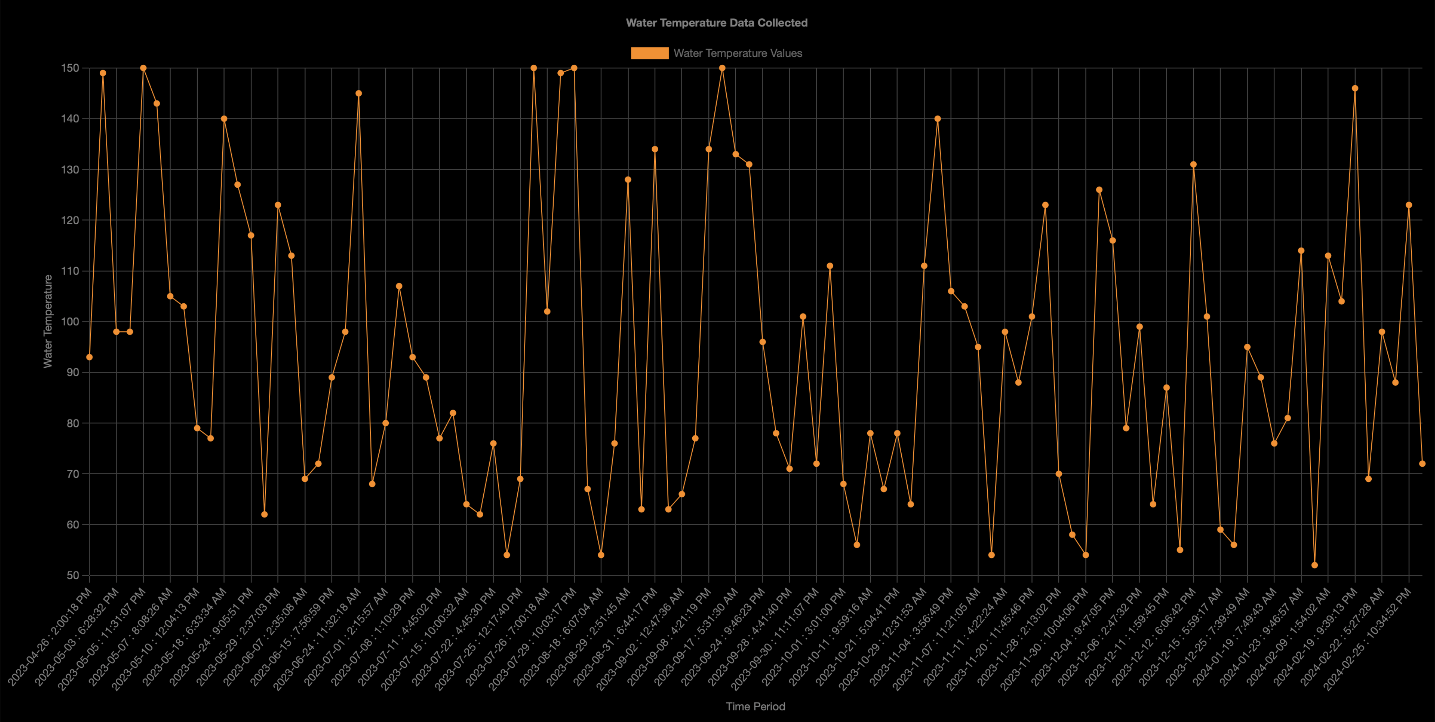
Using IoT Technologies to Wirelessly Monitor and Control Hydroponic Systems
Kevin J. Martes Cruz, Jonathan I. Rodrίguez Guevárez
Advisor: Dr. Manuel A. Jimenez
6. Software Development
1. Introduction
4. Methodology
We are to research the usage of low-power embedded techniques to wirelessly monitor and control hydroponic systems.
The project will focus on studying the suitability of using LoRaWAN technologies for wireless communication throughout the hydroponic system.
We will analyze power consumption, cost, and reliability as main factors to determine suitability.
Waterfall methodology.
Research components needed to accurately monitor and control a hydroponic system.
Research how LoRaWAN can be integrated for wireless communication throughout the system.
Plan modularization of the system and how said system can be scaled.
Hardware and software design.
Interfacing, integrating and testing.
g
5. Results
Figure 2: Diagram of System Network
2. Problem & Hypothesis
The agricultural industry in Puerto Rico has taken a drastic decline over recent years [1]. This decline caused a serious decline in the workforce available for it. The focus of this study will be the effectiveness of LoRaWAN wireless communication technology in the monitoring and controlling of multiple hydroponic systems with large distances between them to increase crop yield with a very limited workforce. We hypothesize that the use of this system can improve product quality and yield due to LoRaWAN’s capabilities of long-range communications of up to 10 miles and very low power consumption making it ideal for rural locations needing IoT integration.
Figure 3: Main Page of WebApp
Table 1: Project Timeline at 2-Week Periods
Figure 4:
View of Graph of a Single Variable Average for All Mock Nurseries
3. Objectives
Correctly source and interface all sensors, solenoids, and pumps to accurately detect, handle, and send all necessary data as well as carry out all given instructions.
Server, database, and dashboard will be setup to provide a working and interactive user interface.
LoRaWAN will be setup to allow for communication with the gateway, enabling it to connect to the internet.
Study the viability of LoRaWAN IoT technologies in a rural, hydroponic environment.
Figure 5: View of Graph of a Single Variable
6. Conclusion
References
After initial prototypes, PCB versions of the boards have been developed.
A working and pretty stable web-app has been developed, although it still has work to be done.
Although used, we still have not proven the viability of using LoRaWAN technologies in our test environment.
Israel Meléndez Ayala, A. K. and D. W. (2021, October 4). Así es como estados unidos controla lo que se come en Puerto Rico (published 2021). The New York Times. https://www.nytimes.com/es/2021/10/04/espanol/opinion/puerto-rico-agricultura.html
Pal, S., Díaz, V.G. and Le, D.-N. (2022) IOT: Security and privacy paradigm, Amazon. Available at: https://docs.aws.amazon.com/iot/latest/developerguide/connect-iot-lorawan-what-is-lorawan.html (Accessed: 10 September 2023).
Program Sponsors:
October 19, 2023
Notes:
1

